Slide 1

How Opinions are Received by Online Communities: A Case Study on Amazon.com Helpfulness Votes
Jon Kleinberg
Dept. of Computer Science
Cornell University
Lillian Lee
Dept. of Computer Science
Cornell University
Cristian Danescu-Niculescu-Mizil
Dept. of Computer Science
Cornell University
Gueorgi Kossinets
Google Inc.
Presentation by Orly Patahov

Slide 2
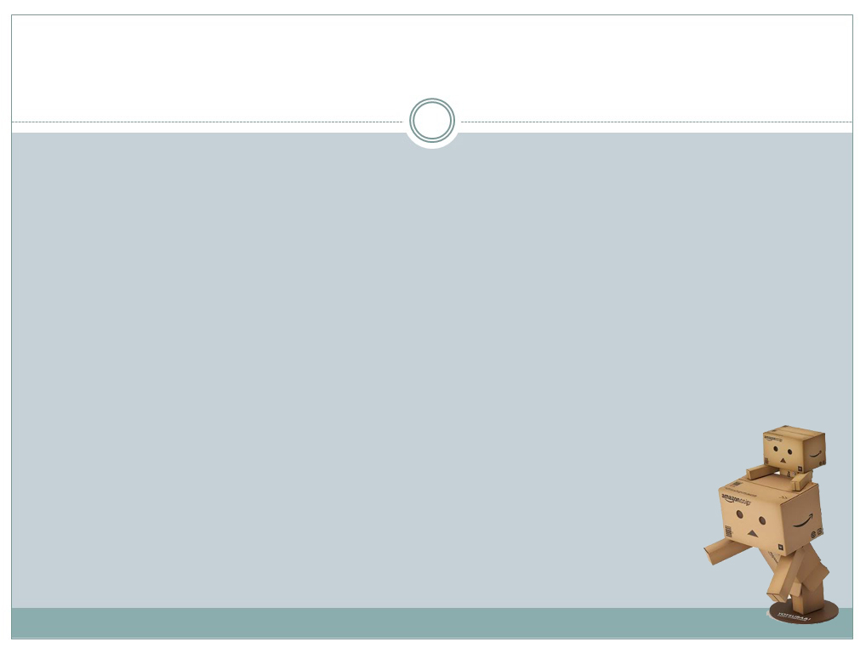
Main Goal
The purpose of this study was to see whether helpfulness evaluations on a site like Amazon.com provide a way to assess how opinions are evaluated by members of an on-line community at a very large scale.
In this study they had developed a framework for understanding and modeling how opinions are evaluated within on-line communities, using a large-scale collection of Amazon book reviews as a dataset.

Slide 3
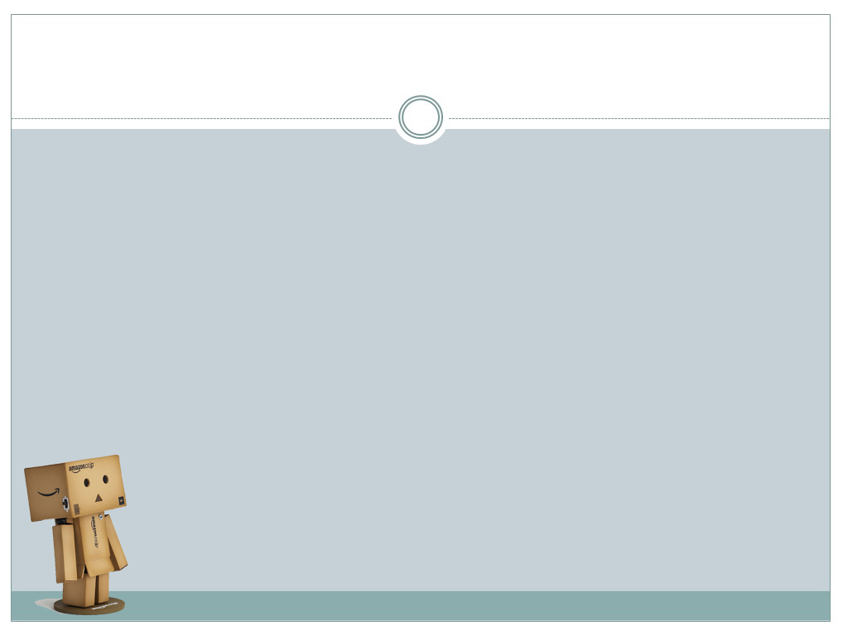


Main Questions
1) Does a review’s perceived helpfulness depends only its content?
2) Do theories from sociology and social psychology work here?
3) Is there a simple model to determine the behavior of this evaluation?

Slide 4
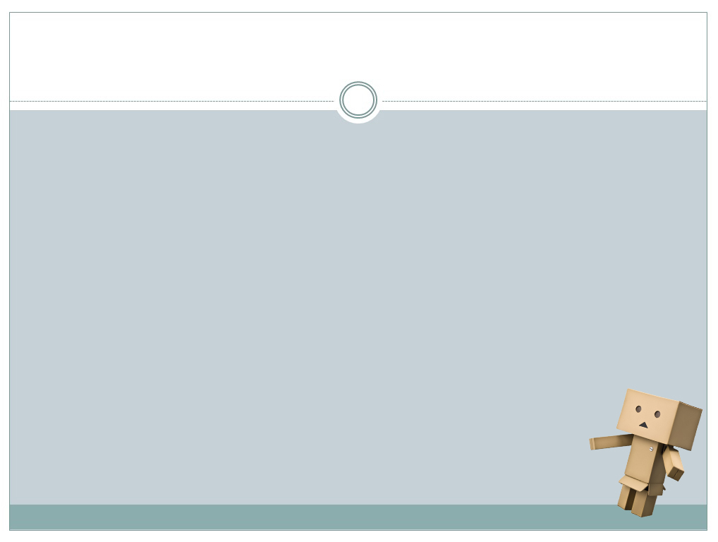
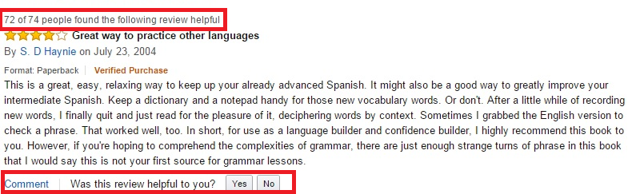
Abstract and Introduction
There are many sites which allow users to review and evaluate other’s reviews on site. One very known example is Amazon.com

Slide 5
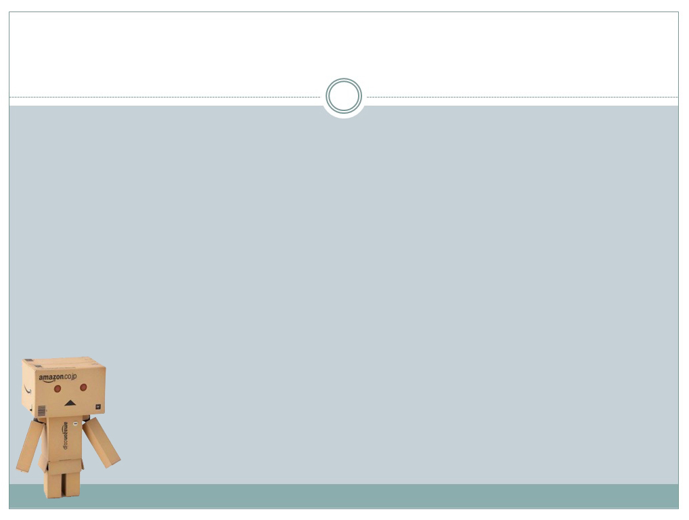


Abstract and Introduction
First we need to understand what evaluating an opinion is.
“What does Y think of X?”
“What does Y think on Z’s thoughts on X?”.

Slide 6


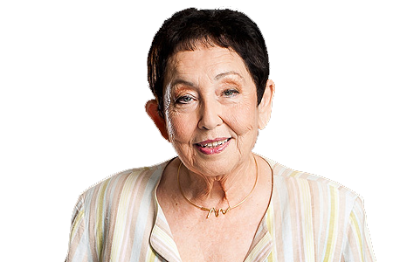
Abstract and Introduction
Such three-level concerns are integral to any study of opinion dynamics in a community.
For example, in political polls:
“How do you feel about the welfare state?”
“How do you feel about Bibi’s position on the welfare state?”

Slide 7
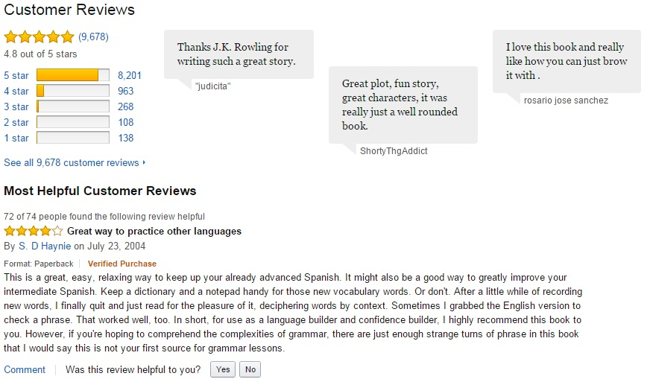
Definitions and Examples from Amazon

Slide 8
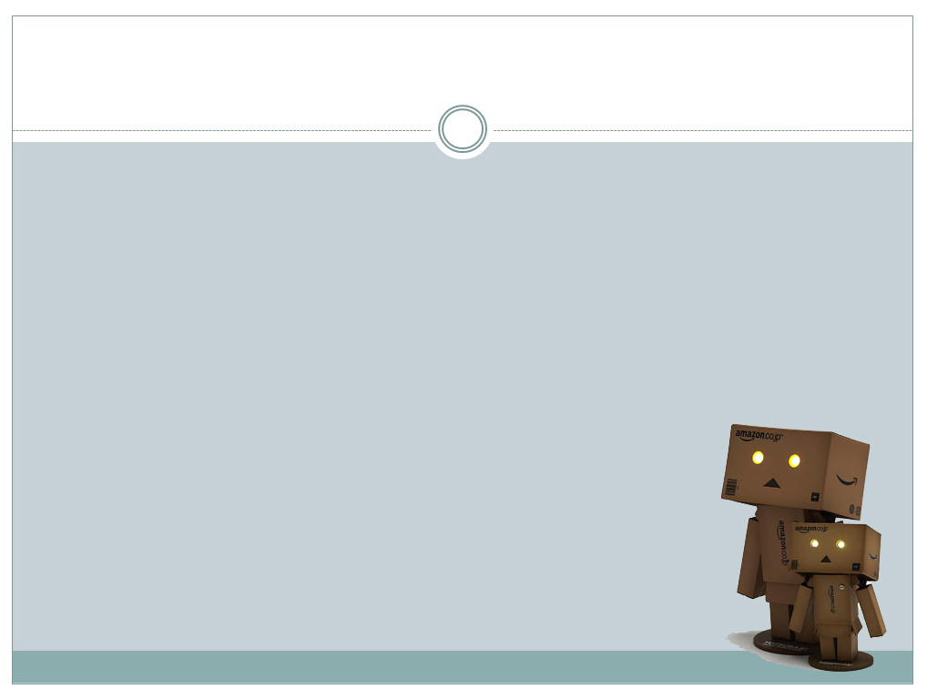

Definitions and Examples from Amazon
Review: A user’s comment based on his/hers opinion on the book, and the product’s star-rating they had chose to assign in the range of [1,5].
Helpfulness evaluation on Amazon: Each user is being asked both “What did you think of the book?” and “What did you think on Y’s review on the book?” = How much did this review assist me with deciding
Whether to purchase this book?
Generally: a/b people thought this review was helpful.

Slide 9
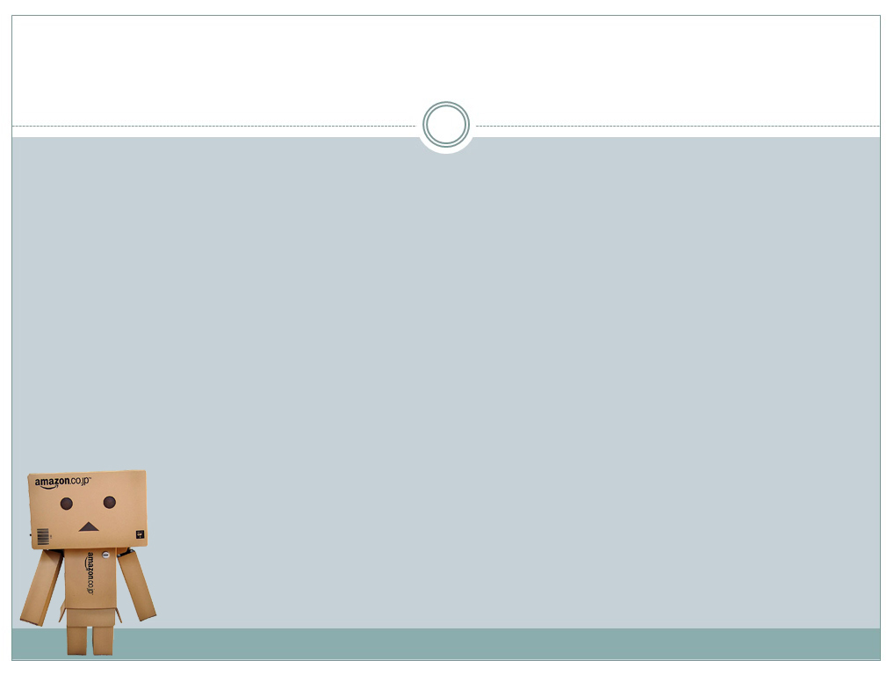
Spoiler Alert!
This research has indicated that helpfulness votes of reviews are not necessarily strongly correlated with the review’s text quality.

Slide 10
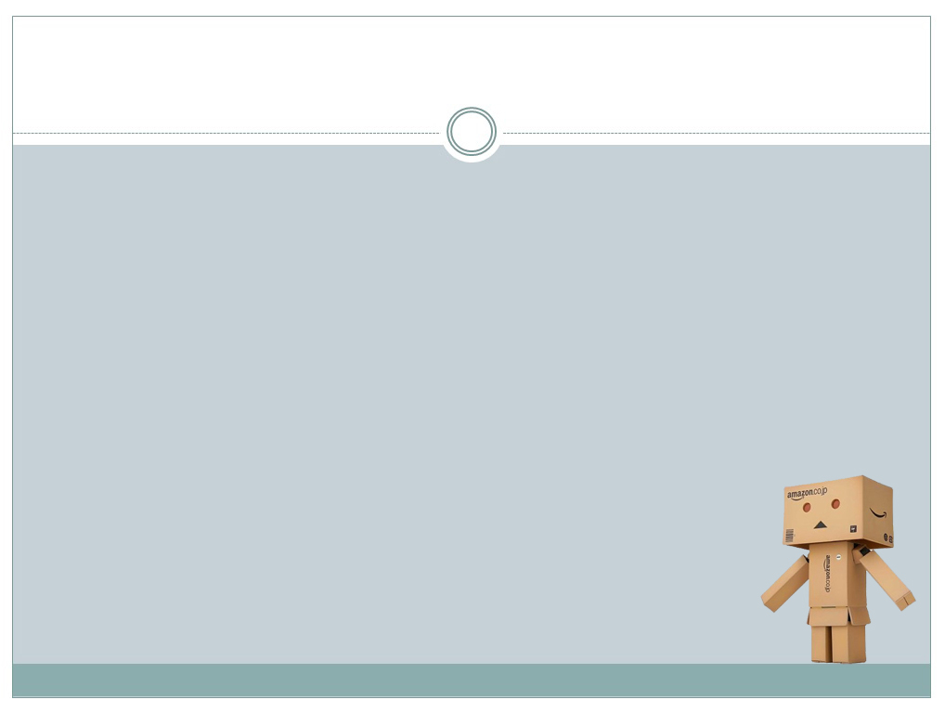
Social mechanisms underlying helpfulness evaluation
1) The conformity hypothesis: holds that a review is evaluated as more helpful when its star rating is closer to the consensus star rating for the product (the average).
2) The individual-bias hypothesis: holds that a user will rate a review more highly if it expresses an opinion that he or she agrees with.
Notes:
2) Rather than evaluating whether a review is close to the mean opinion, a user evaluates whether it is close to their own opinion.

Slide 11
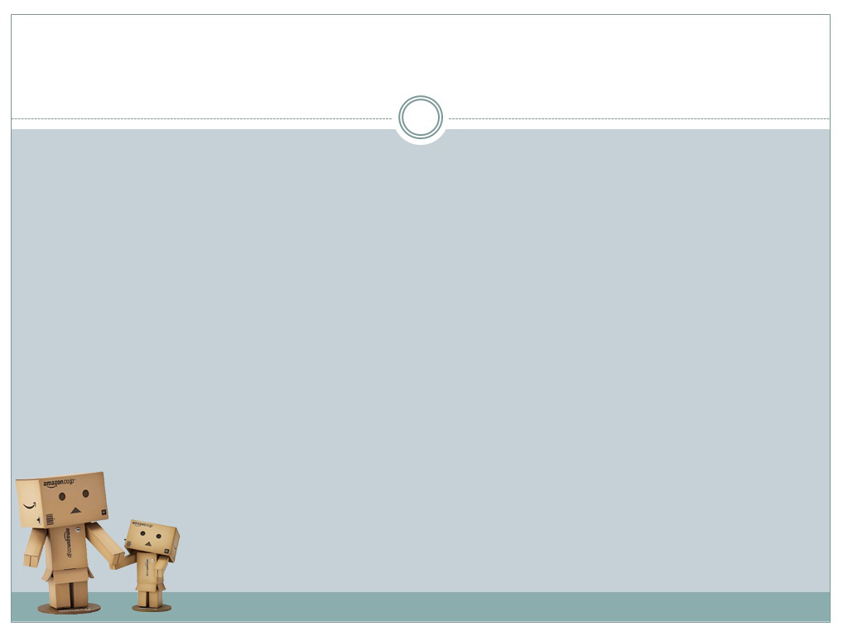
Social mechanisms underlying helpfulness evaluation
3) The brilliant-but-cruel hypothesis: holds that a review is evaluated as more helpful when its star rating is lower than the average star rating for the product.
4) The quality-only straw-man hypothesis: holds that helpfulness is being evaluated purely based on the textual content of the reviews, in ways that are indirectly reflected in other non-textual features (like star rating).
Did the findings of the experiments strengthen or weaken these theories?
Notes:
3) This hypothesis supports the argument that negative reviewers are perceived as more intelligent than positive reviewers.

Slide 12
Dataset
To collect this data there had been made an extensive use of the Amazon Associates Webservice (AWS) API (version 2008-04-07, documentation is available at http://docs.amazonwebservices.com/AWSECommerceService/2008-04-07/DG/).
The API allows one to query for books in a specific Three-Level category.
1. Children’s Books
2.
Animals
3.
Lions
4000 Best selling titles
Most wanted reviews (earliest\helpful etc.)

Slide 13
Dataset preparations
Using the API with the Three-Level queries
Using the AWS for books with 100 or fewer reviews => 99.3%
From the rest (0.7% = 4664 books) take the 100 earliest reviews
Using the AWS for all reviews with at least 10 helpfulness votes
Roughly 675,000 different books from Amazon U.S, U.K, Germany and Japan
book-filtering step to deal with “crossposting” of reviews across versions => total of 674,018 books.
The total dataset contains 1,008,466 reviews

Slide 14
Experiment No. 1: Effects of Deviation from the Average
Goal: To see if there is a connection between the distance from the assigned star rating in a review to the average star rating of the product, and the review’s helpfulness ratio.
Definitions:
Product average = the mean star rating from all the reviews of this product (from the dataset).
Helpfulness ratio = a/b where a users had found this review helpful out of all b raters.
Deviation from the mean =
|product’s average star rating – review’s star rating|
Notes:
Product average != to the “Amazon’s displayed product average star rating” score since we’re looking at the dataset only and not all the reviews, and since Amazon rounds the average to the nearest half-star (e.g. 3.8->4), and this is a problem on its own.

Slide 15
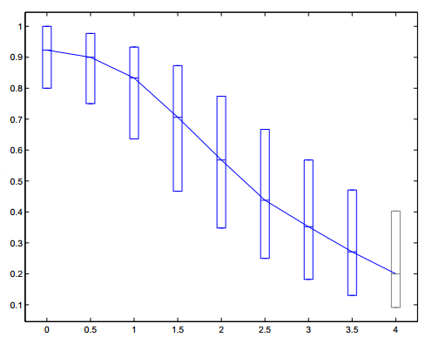
Experiment No. 1: Effects of Deviation from the Average
Figure 1
Consistent with theory 1!
Helpfulness ratio
Absolute deviation

Slide 16
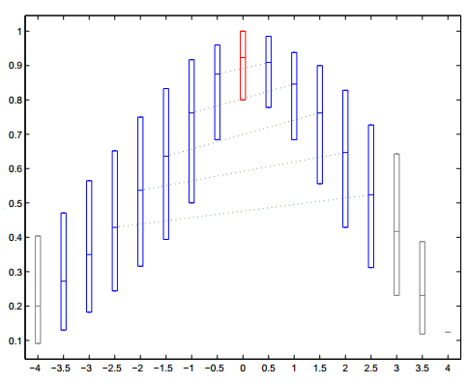
Experiment No. 1: Effects of Deviation from the Average
Figure 2
Contradicts theory 3!
Inconsistent with theory 1!
Helpfulness ratio
Signed deviation

Slide 17
Experiment No. 1: Effects of Deviation from the Average
This contradicts the brilliant-but-cruel hypostasis since among reviews with the same absolute deviation |x| > 0, the relatively positive ones (signed deviation |x|) generally have a higher median helpfulness ratio than the relatively negative ones (signed deviation -|x|).
This is also inconsistent with the conformity hypothesis because of the asymmetry, since that hypothesis incorrectly predicts that the connecting lines would be horizontal.
Notes:
Reminder: According to the conformity theory (1) the most helpful reviews should be the ones with 0 deviation from the mean, and according to the brilliant-but-cruel theory (3) the helpfulness should be higher to those reviews with negative deviation.

Slide 18
Experiment No. 2: Effects of Variance and Individual Bias
To account for Figure 2, one could simply impose upon the conformity hypothesis (1) an extra “tendency towards positivity” factor, but this would be quite unsatisfactory: it wouldn’t suggest any underlying mechanism for this factor.
So, we turn to the individual bias hypothesis (2) instead.

Slide 19
Experiment No. 2: Effects of Variance and Individual Bias
In order to distinguish between conformity effects and individual bias effects, we need to examine cases in which individual people’s opinions (product’s star rating) do not come from exactly the same (single-peaked, say) distribution.
Otherwise, the composite of their individual biases could produce helpfulness ratios that look very much like the results of conformity.

Slide 20
Experiment No. 2: Effects of Variance and Individual Bias
We therefore seek out subsets of the products on which the two effects might be distinguishable:
1. Associate with each product the variance of the star ratings assigned to it by all its reviews.
2. Group products by variance [0,0.5,…4].
3. Perform the signed-difference analysis above on sets of products having fixed levels of variance.

Slide 21
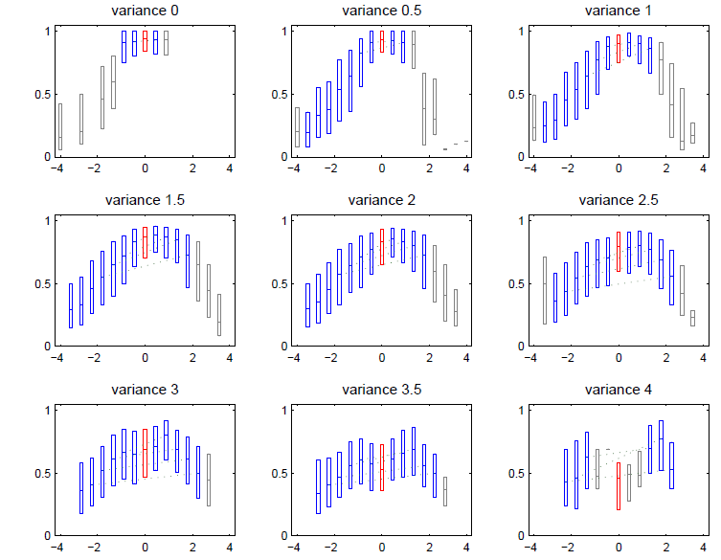
Experiment No. 2:
Consensus
Helpfulness ratio
Signed deviation
Controversy

Slide 22
Experiment No. 2: Effects of Variance and Individual Bias
Findings:
1. As variance increases, the “camel plots” go from a single hump to two.
2. When the variance is very low, the reviews with the highest helpfulness ratios are those with the average star rating.
3. With moderate values of the variance, the reviews evaluated as most helpful are those that are slightly above the average star rating.
4. As the variance becomes large, reviews with star ratings both above and
below the average are evaluated as more helpful than those that have
the average star rating (with the positive reviews still deemed
somewhat more helpful).

Slide 23
Experiment No. 2: Effects of Variance and Individual Bias
Our findings are consistent with the individual bias hypothesis (2).
We can clearly find some “Rules” for how — all other things being equal — one can seek good helpfulness evaluations in our setting:
With low variance go with the average
With moderate variance be slightly above average
With high variance avoid the average
These results indicate that variance is a key factor that any hypothesis
needs to incorporate.
Notes:
Reminder: The individual-bias hypothesis (2) holds that when a user considers a review, he or she will rate it more highly if it expresses an opinion that he or she agrees with.

Slide 24
Experiment No. 3:
Controlling for the Text Quality :
Experiments with “Plagiarism”

Slide 25
Experiment No. 3: Controlling for the Text Quality
We have shown that helpfulness ratios appear to be dependent on two key non-textual aspects of reviews:
1. Deviation from the computed star average.
2. Star rating variance within reviews for a given product.
As we have noted, our analyses do not explicitly take into account the actual text of reviews.
Can these results be simply explained by the review quality?
Can the straw-man quality-only hypothesis (4) explain it all?

Slide 26

Experiment No. 3: Controlling for the Text Quality
First idea that comes to mind: read a sample of reviews and determine whether the Amazon helpfulness ratios assigned to these reviews are accurate.
The problems:
1. It would require a great deal of time and human effort to gather a sufficiently
large set of re-evaluated reviews.
2. Human re-evaluations can be subjective.

Slide 27

Experiment No. 3: Controlling for the Text Quality
Second idea that comes to mind: use machine learning to train an algorithm to automatically determine the degree of helpfulness of each review.
The problem:
any mismatch between the predictions of a trained classifier and the helpfulness ratios observed in held-out reviews could be attributable to errors by the algorithm (blame it on the machine).

Slide 28

Experiment No. 3: Controlling for the Text Quality
Solution:
Rather than try to re-evaluate all reviews for their helpfulness, we can focus on reviews that are guaranteed to have very similar levels of textual quality.
Amazon data contains many instances of nearly-identical reviews and identical reviews must necessarily exhibit the same level of text quality.
Therefore, this article exploits the “Plagiarism phenomenon”
on Amazon to control for text quality.

Slide 29
Experiment No. 3: Controlling for the Text Quality
Identifying “plagiarism” (as distinct from “justifiable copying”)
1. We only considered pairs of reviews where the two reviews were posted to different books — this avoids various types of relatively obvious self copying.
2. Next adapted the code of Sorokina et al. from the “Plagiarism Detection in arXiv.or” article to identify those pairs of reviews of different products that have highly similar text.
3. We employed a threshold of 70% or more nearly duplicate sentences,
where near-duplication was measured via the code of Sorokina et al.

Slide 30
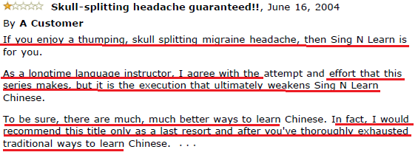
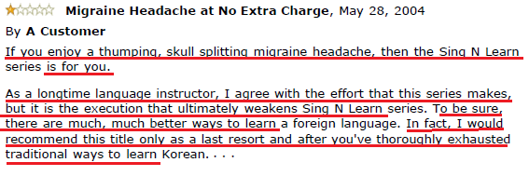
Experiment No. 3: Controlling for the Text Quality
The resulted dataset considered 8,313 “plagiarized” pairs.

Slide 31
Experiment No. 3: Controlling for the Text Quality
Confirmation that text quality is not the (only) explanatory factor
Note: A statistically significant difference between the helpfulness ratios of the member of such “plagiarized” reviews pair is a strong indicator of the influence of a non-textual factor on the helpfulness evaluators.
Some non-textual factors we wont be talking about: geographic location, gender, length of the review etc.

Slide 32
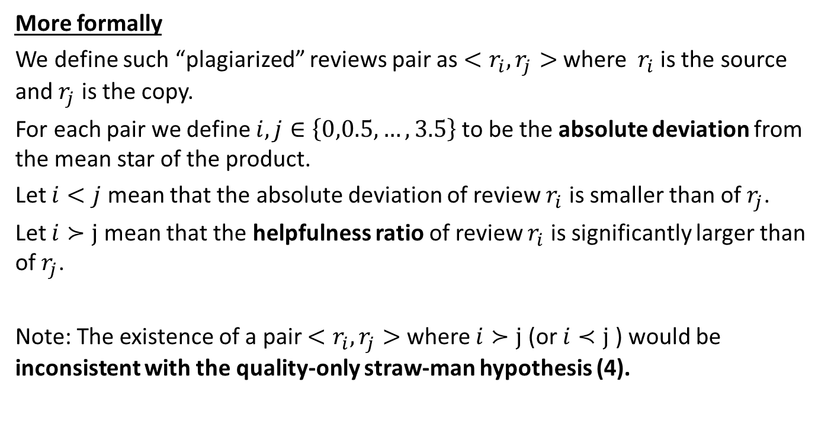
Experiment No. 3: Controlling for the Text Quality
More formally
We define such “plagiarized” reviews pair as ${<r}_{i},r_{j}>$ where $r_{i}$ is the source and $r_{j}$ is the copy.
For each pair we define $i,j∈\left\{0,0.5,…,3.5\right\}$ to be the absolute deviation from the mean star of the product.
Let $i<j$ mean that the absolute deviation of review $r_{i}$ is smaller than of $r_{j}$.
Let $i≻j$ mean that the helpfulness ratio of review $r_{i}$ is significantly larger than of $r_{j}$.
Note: The existence of a pair ${<r}_{i},r_{j}>$ where $i≻j$ (or $i≺j$) would be inconsistent with the quality-only straw-man hypothesis (4).

Slide 33
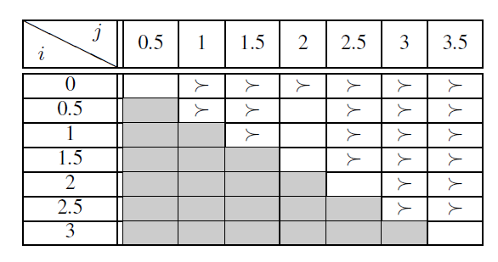
Experiment No. 3: Controlling for the Text Quality
Table 1: absolute deviation

Slide 34
Experiment No. 3: Controlling for the Text Quality
Findings:
1. It is clear that “plagiarized” reviews with a lower absolute deviation (closer to the average) tend to have larger helpfulness ratios than duplicates with higher absolute deviations.
2. This table is consistent with figure 1 (experiment 1) which showed that the helpfulness ratio is inversely correlated with absolute deviation prior to controlling for text quality.

Slide 35
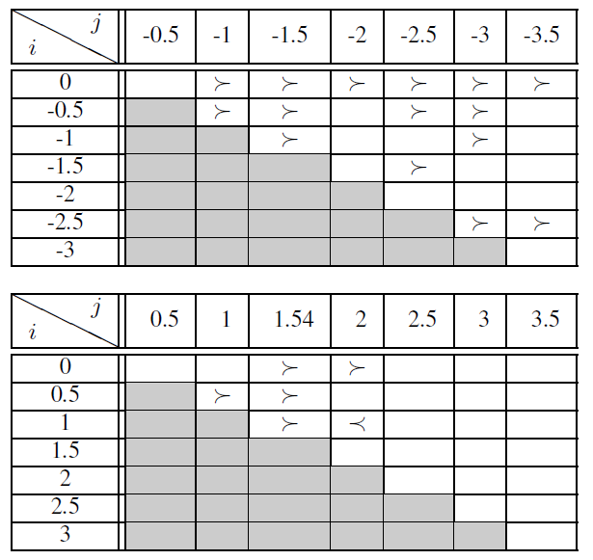
Experiment No. 3: Controlling for the Text Quality
Table 2: signed deviation

Slide 36
Experiment No. 3: Controlling for the Text Quality
Findings:
1. All but one of the statistically significant results indicate that “plagiarized” reviews with star rating closer to the product average are judged to be more helpful.
2. This table is consistent with figure 2 (experiment 1): the upper (resp. lower) table is consistent with the left (resp. right) side of figure 2
Contradicts theory 4!

Slide 37
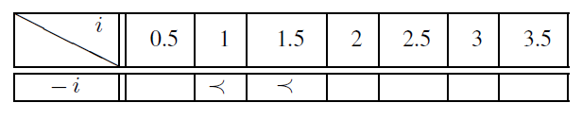
Experiment No. 3: Controlling for the Text Quality
Table 3: signed deviation
Findings:
1. This table is consistent with the asymmetrically of figure 2 (experiment 1) – there is a tendency towards positivity.

Slide 38

Up until now…
1) Does a review’s perceived helpfulness depends only on its content? – No!
2) Do theories from sociology and social psychology work here? – Not all of them! only the individual bias hypothesis.
3) Is there a simple model to determine the behavior of this evaluation?

Slide 39
A Model based on Individual Bias and Mixtures of Distributions

Slide 40
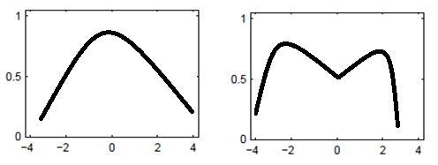
A Model based on Individual Bias
1. The model is based on individual bias, as it is the only hypothesis that explained the findings, with a mixture of opinion distributions.
2. The main findings about helpfulness, variance, and deviation from the mean are consistent with this simple model.
3. The model exhibits the phenomenon observed in our data that increasing the variance shifts the helpfulness distribution so it is first unimodal (only a single highest value) and subsequently (with larger variance) develops a local minimum around the mean.

Slide 41
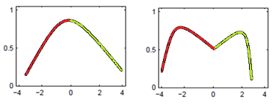
A Model based on Individual Bias
4. The model assumes that helpfulness evaluators can come from two different distributions: evaluators who are positively disposed toward the product (positive), and the other consisting of evaluators who are negatively disposed toward the product (negative).

Slide 42
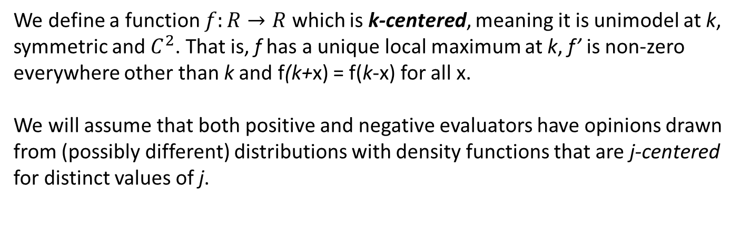
A Model based on Individual Bias
We define a function $f:R→R$ which is k-centered, meaning it is unimodel at k, symmetric and $C^{2}$. That is, f has a unique local maximum at k, f’ is non-zero everywhere other than k and f(k+x) = f(k-x) for all x.
We will assume that both positive and negative evaluators have opinions drawn from (possibly different) distributions with density functions that are j-centered for distinct values of j.
Parameters:
Balance p between positive and negative (q=1-p) reviewers.
controversy level α > 0 is the distance between the peaks of the two distributions (positive and negative), thus related to the variance.

Slide 43
A Model based on Individual Bias
Assumptions:
for some number k, the density function f for positive evaluators is
(k + qα)-centered, and the density function g for negative evaluators is
(k + pα)-centered.
=> the density function for the full population is h(x) = pf(x) + qg(x) = k.
=> The mean and balance are fixed and the controversy level α is the variable.
Under our individual-bias assumption, each user has an opinion x drawn from h and regards a review as helpful if it expresses an opinion that is within a
small tolerance of x (x-ε,x+ε).

Slide 44
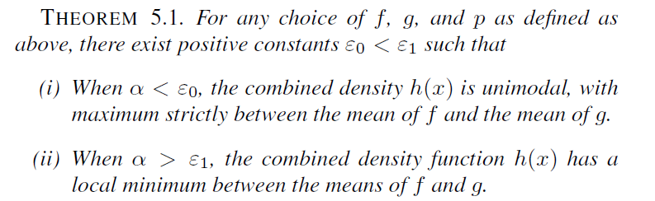
A Model based on Individual Bias

Slide 45
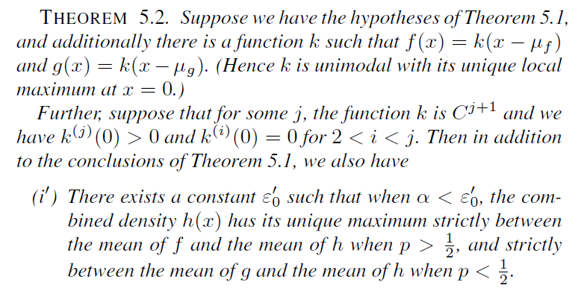
A Model based on Individual Bias

Slide 46
A Model based on Individual Bias
Both of these theories had been proven by this study, and also by considering the shape of h(x) we see that this behavior is the exact same one observed in the original data!
Therefor, we expect that the helpfulness ratio of reviews can be approximated by h(x).

Slide 47
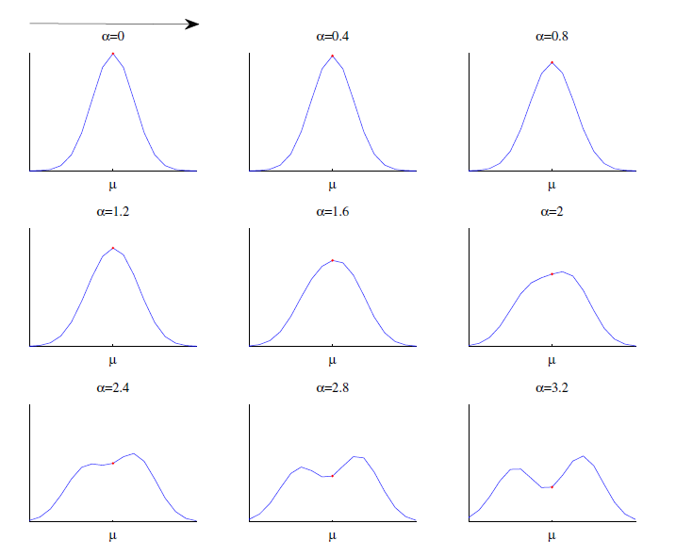
A Model based on Individual Bias
Gaussians are one basic example
of a class of density functions
satisfying this condition:
f and g are Gaussian translates,
p fixed, α changing and hence
changing the variance.

Slide 48
Up until now…
1) Dose a review’s perceived helpfulness depends not just on its content? – No!
2) Do theories from sociology and social psychology work here? – Not all of them! only the individual bias hypothesis.
3) Is there a simple model to determine the behavior of this evaluation? – Yes! based on individual bias and mixtures of opinions distributions.

Slide 49
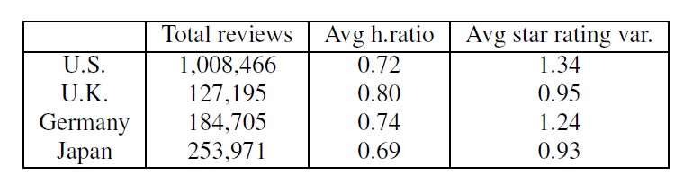
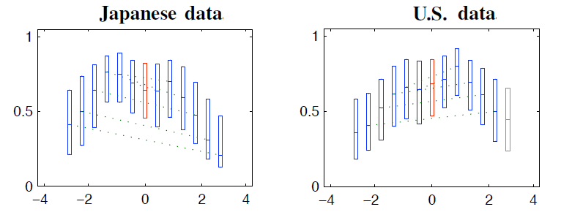
A note about consistency among countries
There are noticeable differences between reviews collected from different regional Amazon sites (Amazon.com (U.S), Amazon.co.uk (U.K), Amazon.de (Germany) and Amazon.co.jp (Japan)), in both average helpfulness ratio and review variance.
Curiously enough, for the Japanese data, we observe that reviews with star ratings below the mean are more favored by helpfulness evaluators. In the context of our model, this would correspond to a larger proportion of negative evaluators (balance p < 0.5).

Slide 50
Conclusions
# We have seen that helpfulness evaluations on a site like Amazon.com provide a way to assess how opinions are evaluated by members of an on-line community at a very large scale.
# A review’s helpfulness ratio depends not just on its content, but also on the relation of its score to other scores.
# This dependence on the score contrasts with a number of theories from sociology and social psychology.
# It is consistent with a simple and natural model of individual bias in
the presence of a mixture of opinion distributions.

Slide 51
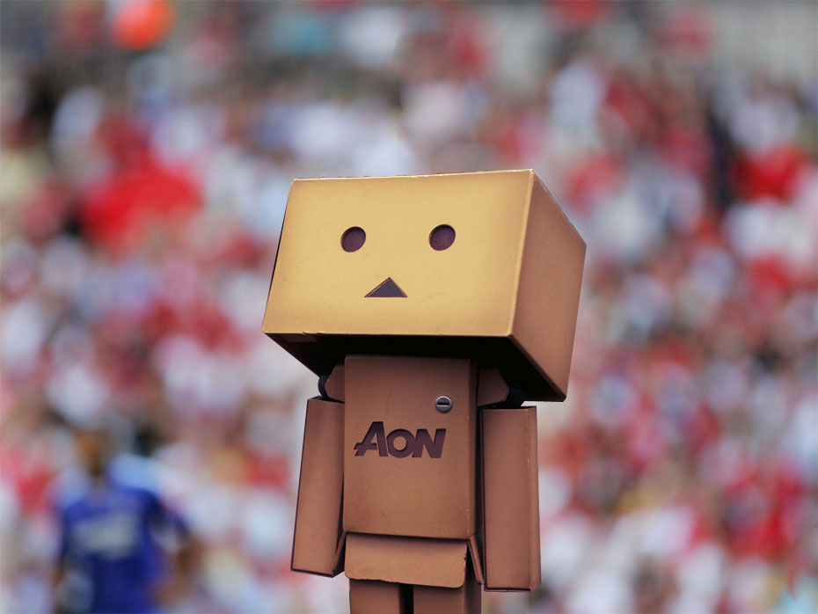
In an online community, if you’re lost, go with the majority, unless they are also lost.

Slide 52
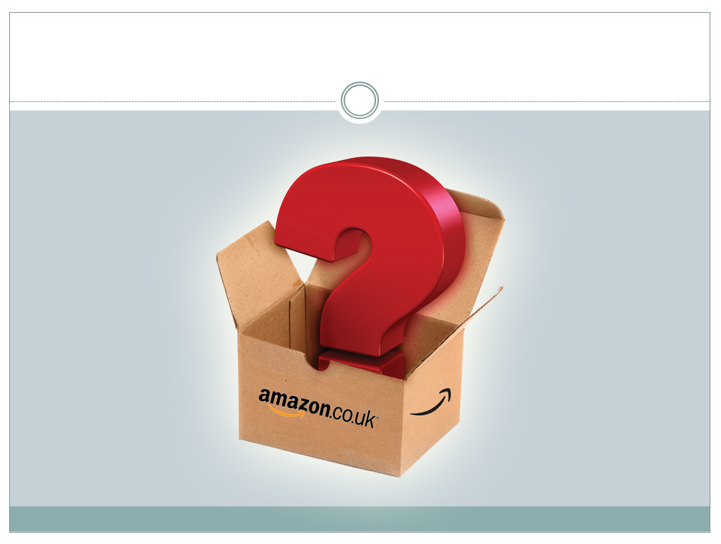
Questions?

